Slide 1
NHS Staffing and Resource Utilization Analysis for Network Operations
Matteo Natalini

Slide 2
Business context

Slide 3

Business concerns and questions posed
The NHS incurs significant, potentially avoidable, costs when patients miss general practitioner (GP) appointments. The reasons for missed appointments need to be better understood.
QUESTIONS:
Has there been adequate staff and capacity in the networks?
What was the actual utilisation of resources?

Slide 4


Our approach to the problem
DATA EXPLORATION, DATA WRANGLING, AND VISUALISATION WITH PYTHON:
Descriptive and diagnostic analysis of historical data of appointments at general practitioner (GP) surgeries across the country.
Data wrangling using data from Tweeter.
GITHUB
https://github.com/Matteo-Natalini/DA201_Assignment

Slide 5
Analyse the data

Slide 6
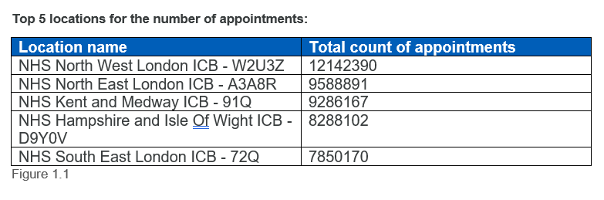
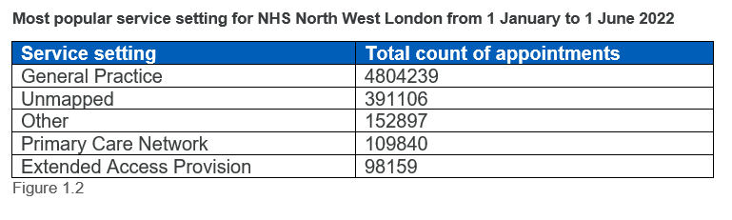

Pattern trend and insights
Data range is from August 2021 to June 2022
106 locations in the dataset
General Practice is used as the service setting for 86.47% of total appointments

Slide 7
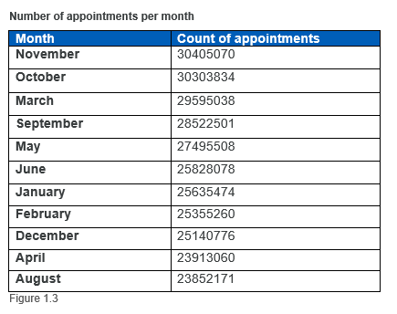

Pattern trend and insights
November has the highest amount of appointments and August has the lowest

Slide 8
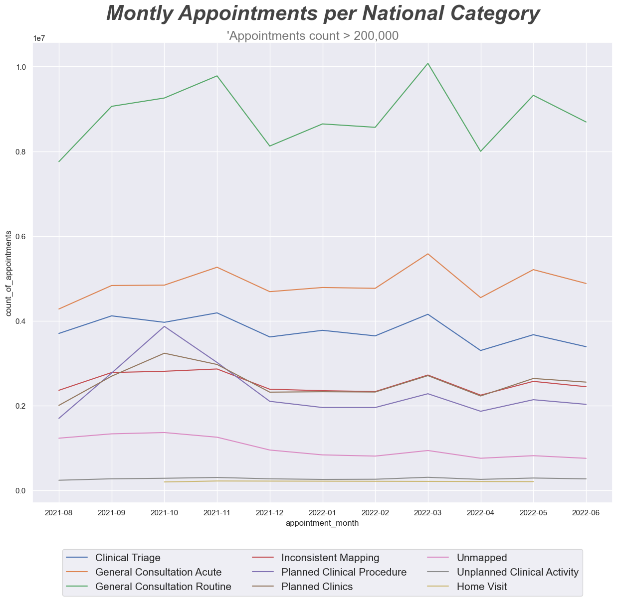

National categories investigation
1st place: General consultation routines
Planned clinical procedure rise in October

Slide 9

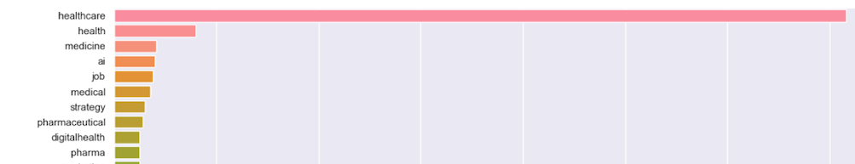
Twitter
Top 10 most tweeted hashtag about NHS

Slide 10

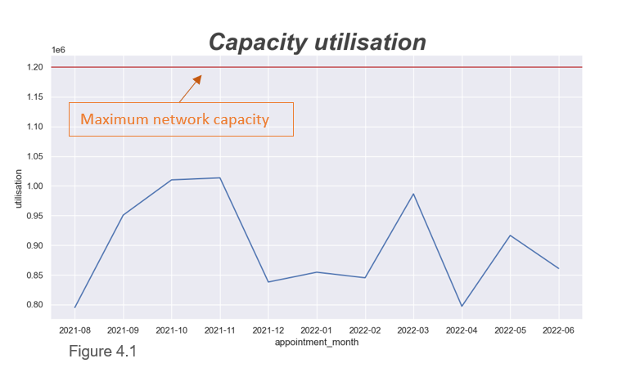
Resource utilisation
Monthly average daily capacity utilisation = total appointment / 30
NSH network maximum daily capacity = 1.2 million
Please note: there may have been days where the maximum capacity was exceeded due to the presence of outliers that are not visible to us

Slide 11
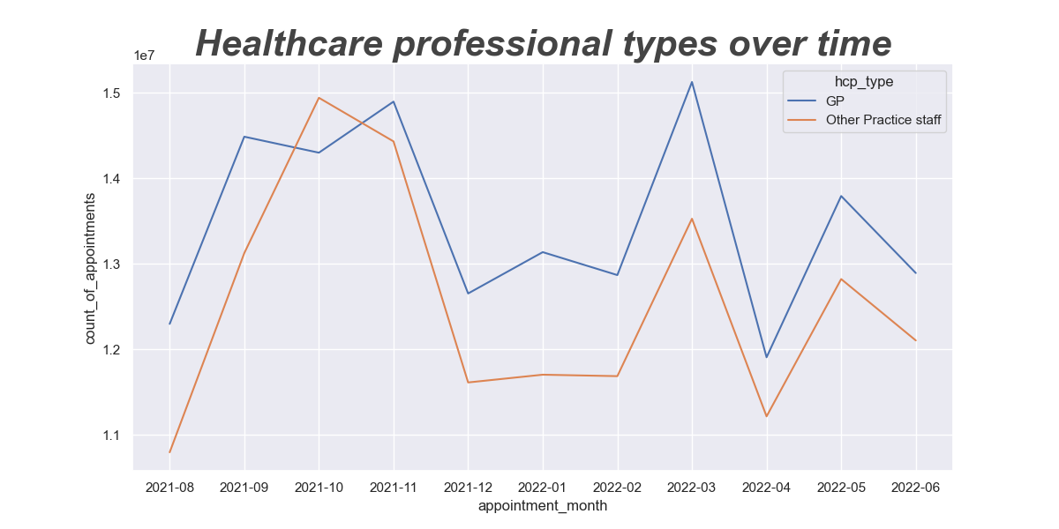

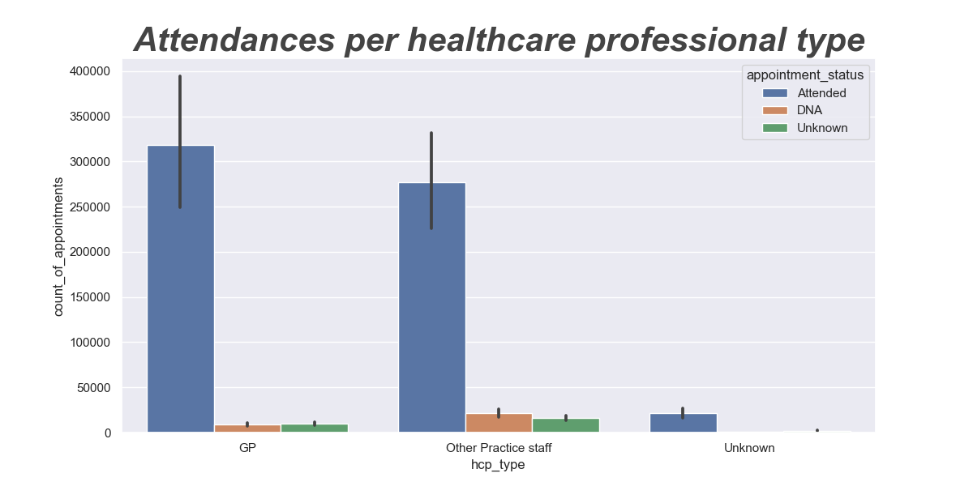


Healthcare professionals
October shows a change in pattern between the two categories
6.88% of the appointments with practice staff that are not a GP are not attended by patients
2.64% GP not attendance rate

Slide 12
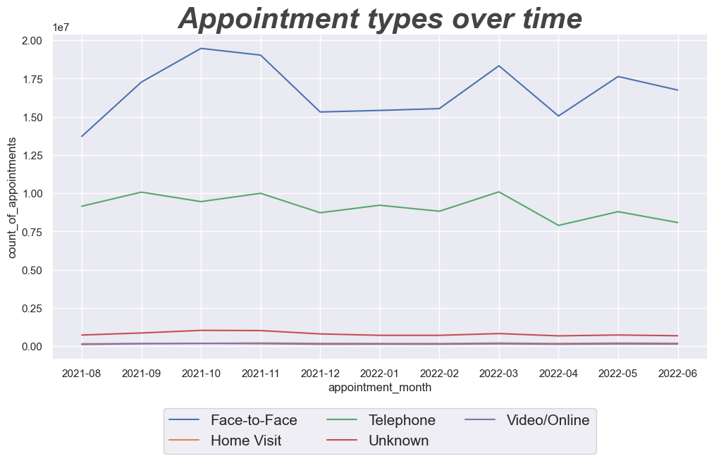


Appointment types
Telephone visits have a more constant trend during a busy month

Slide 13
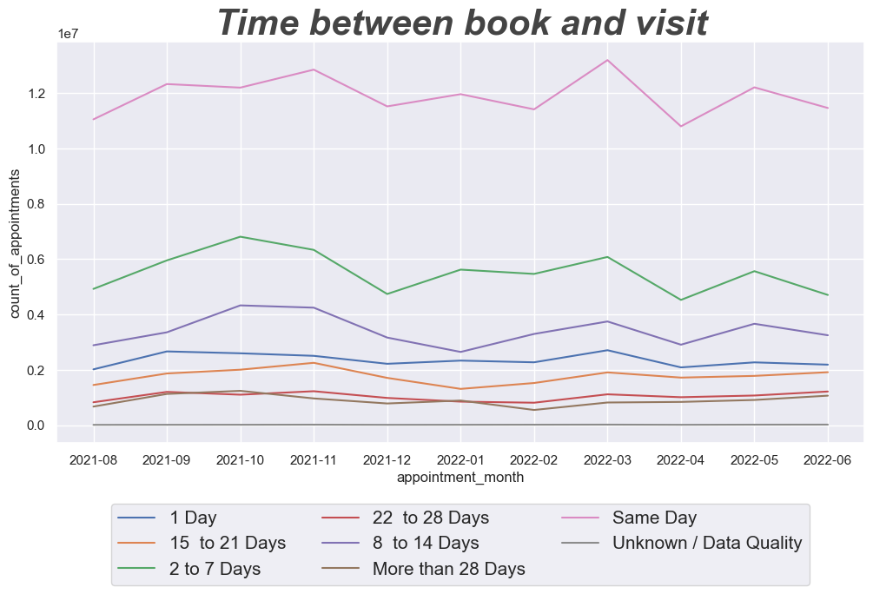


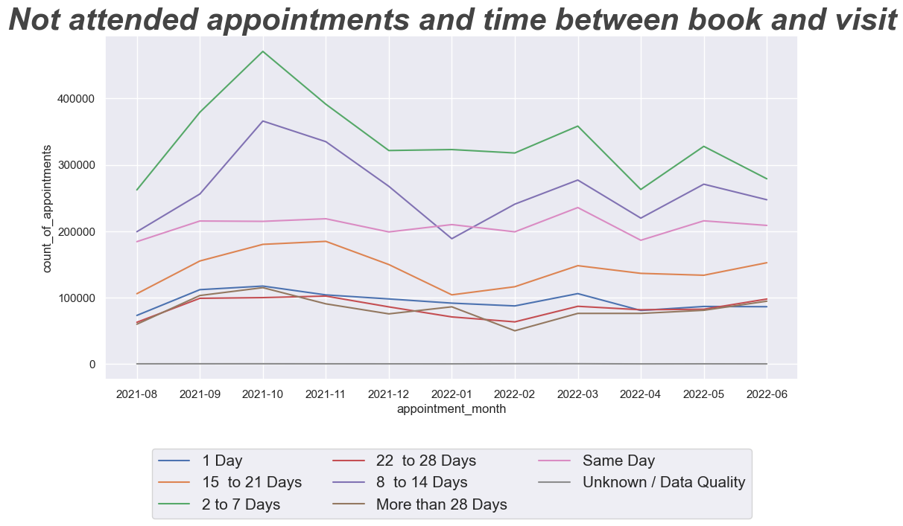

Time between book and visit
Most appointments are booked for the same day
Missed appointments booked on the same day are most consistent during busy months in winter

Slide 14
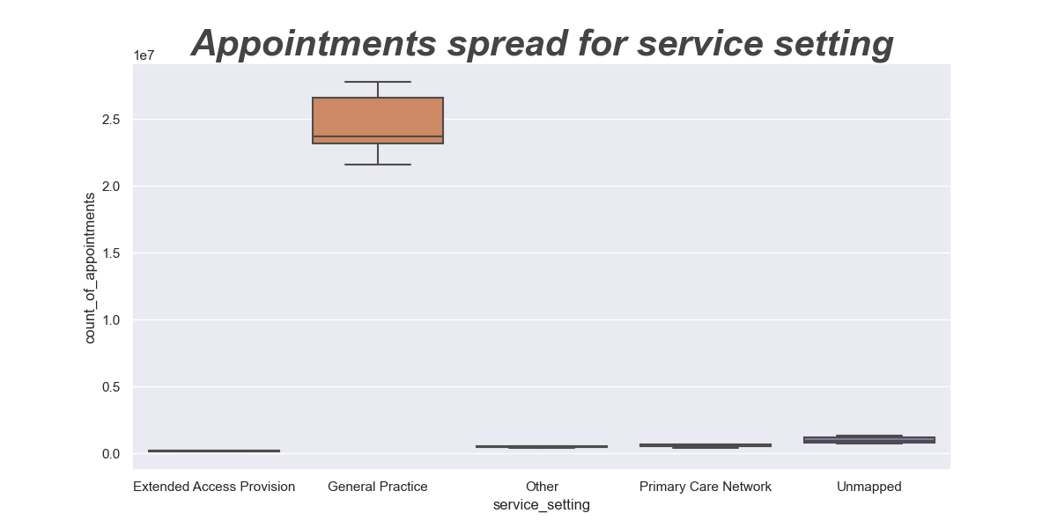

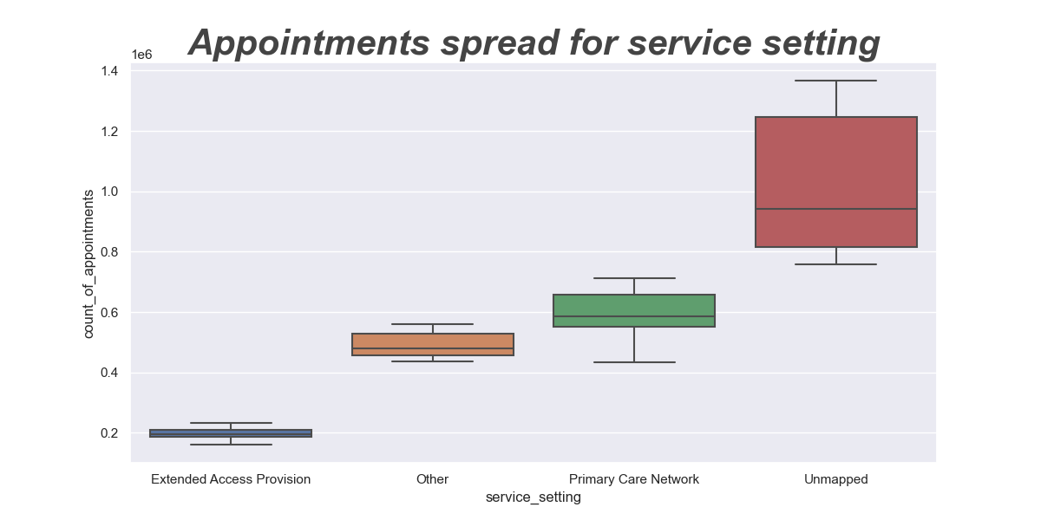
Service setting and spread of appointments
General practices are the busiest service setting
Primary Care Network potential
It is recommended to improve the mapping system for future analysis

Slide 15

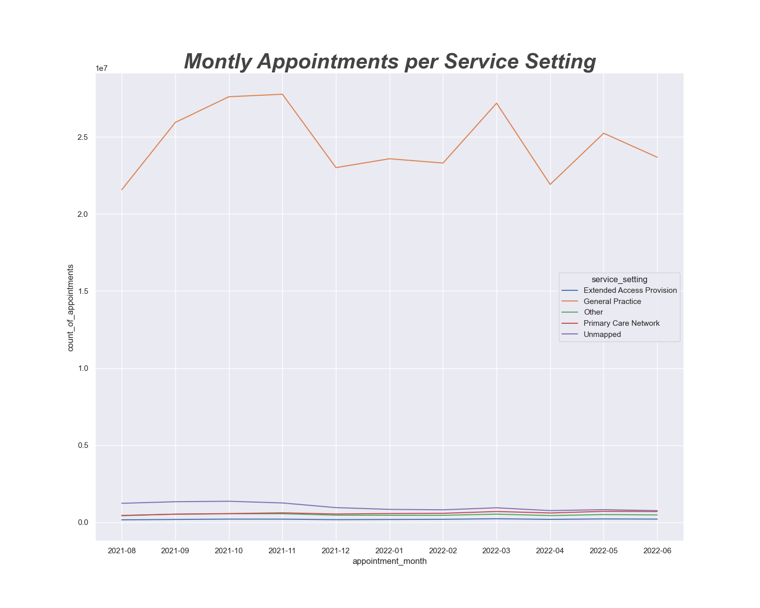
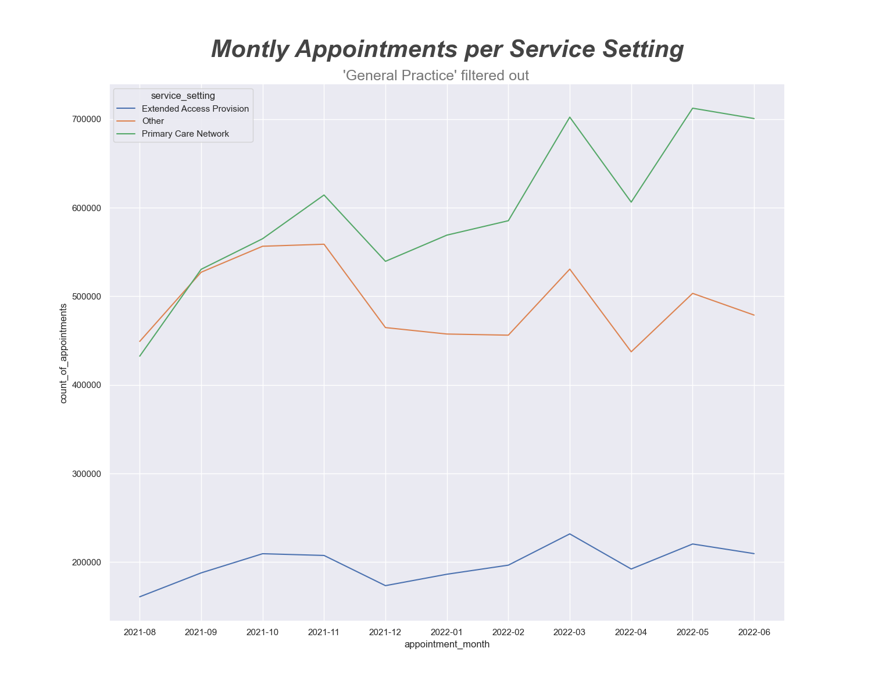

Service setting investigation

Slide 16


Conclusions
October, November and March are the busiest months
Try to avoid in October planned clinical procedure
Spotted high rate of missed appointments when the healthcare professional is not a GP
Investigate
Telephone visits being more consistent during busy time
Improve video
Average utilisation capacity on average is not exceeded
Daily data for more accurate results in future analysis
Primary Care Network potential and increasing utilisation
Improve mapping of service setting to have more date and follow this trend

Slide 17
Thank you

